Slide 1
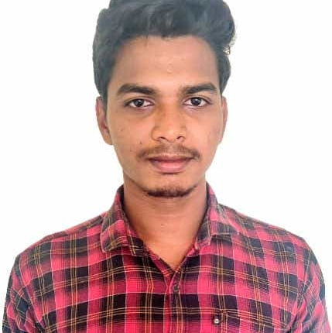
Sekhar Makkella
Bachelor of Technology, Computer Science : 2017 - 2021
Analyst/Software Engineer
Skills
Languages | C ,java- OOPS, Generics, Collections, Array, Loops , python-basics
Backend technologies | Spring Boot/Spring Security REST-API NodeJS
Database | Postgres sql
Angular | Components, Hooks, Virtual DOM, Routing, Forms & Validation​
Web Technology | HTML5 & CSS3 and JavaScript, Typescript, Bootstrap
Tools | Git, Postman, Swagger, Visual Studio code, Gradle
Add On skills | Self Learning, Communication Skills, Team Management
Mumbai
makkella.sekhar@capgemini.com
+91 6304961368
A4
Online Shopping
Complete end to end case study of online shopping using Spring Boot REST API and Swagger. Securely implemented authentication with JWTs. Created UI using HTML, CSS, Bootstrap and Angular.
A self-driven learner with Front End and Back End knowledge. Passionate about implementing and launching new projects.
Ready to learn new technologies and Frameworks and implement them to further improve my knowledge.
A team player with good communication skill always ready to work for the enrichment of knowledge.

